Slide 1
ENSE 374, Milestone 1
Daniel Takyi
Jiwoun Kim
Mason Lane

Slide 2
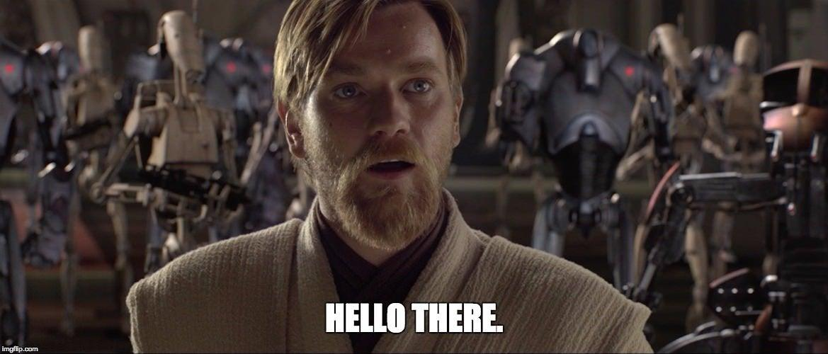
Team: They Will
https://github.com/jiwoone/ENSE-374-Project.git

Slide 3
GitHub
https://github.com/jiwoone/ENSE-374-Project.git

Slide 4
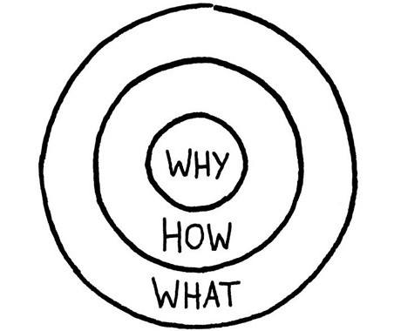
Golden Circle
Why?: We’re bad at making decisions, indecisive, dislike responsibilities.
Also bored, seeking something new, and unique.
How?: Something that can help us make decisions and explore; simple to use and convenient.
Something fun that you don’t experience on a daily basis.
What?: A random list of generated food locations within a city. Expanding on “wheel decide”

Slide 5
Elevator Pitch
None of us really like having all the responsibility on our shoulders. However we still want some level of control over our surroundings. We need something able to lessen responsibility by helping us with decisions. That’s why we have thought of a food generator, which can ease our load of decision making on a daily basis in a playful way.

Slide 6
Goals, Vision and Stakeholders
Our idea is to give users the ability to explore , experiment or simply enjoy the convenience we aim to supply.
Therfore, we want to expand on apps like wheel decide, adding area-based features from google maps (or other) results
There doesn't appear to be an app that makes food decisions for you with specific franchise names.
You want a burger? Okay, but *where*?

Slide 7
Requirements/assumptions
As a MVP, we would start with pre-queried results for the regina area, and quickly expand to allow custom areas and ranges. Users should be able to select their desired distance.
Further, we could enable search functions to allow user’s a broader range of uses - not limited to food locations
It has to be handy - something someone can use moments before getting to their garage or parking lot. So while starting with a browser based app, it still needs to be mobile friendly.
We share some concerns over the difficulty in implementing queried map results
We assume we might need some kind of access to google’s assets. Likely needing a google_maps_api key

Slide 8
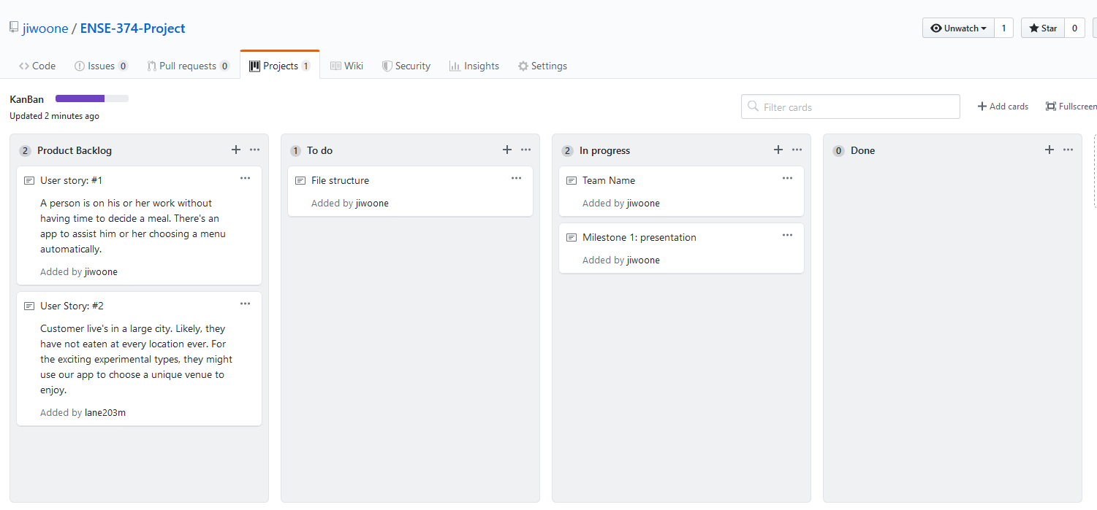
Initial Kanban

Slide 9
GitHub
https://github.com/jiwoone/ENSE-374-Project.git
https://github.com/jiwoone/ENSE-374-Project/projects/1

Slide 10
Group reflection
•How did you feel about this milestone? What did you like about it? What did you dislike?
•Mixed opinions. Slightly confusing, possibly too early for some information.
•What did you learn about yourself as you collaborated and worked through this milestone?
•Were bad at team names, and have no decision making skills (hense app)
•How will you use what you have learned going forward?
•Kanban, how to get/implement google maps information. And how to integrate this into an app
•What “stuff & things” related to this milestone would you want help with?
•How to integrate google maps/results with an app. Internet communication, etc, etc.

